Slide 1





Code Basics
F&B INDUSTRY
SURVEY
Presented By :
Vishal Nimbolkar

Slide 2


AGENDA
Need of Project
Scope
Data Given
Visualization
Technology Used

Slide 3

PROJECT NEED
CodeX is a German beverage company that is aiming to make its mark in the Indian market. A few months ago, they launched their energy drink in 10 cities in India and by making the survey received results from '10k' respondents. The major goal is to turn these survey results into actionable insights for the team.
Brand awareness
Market share
Product development

Slide 4

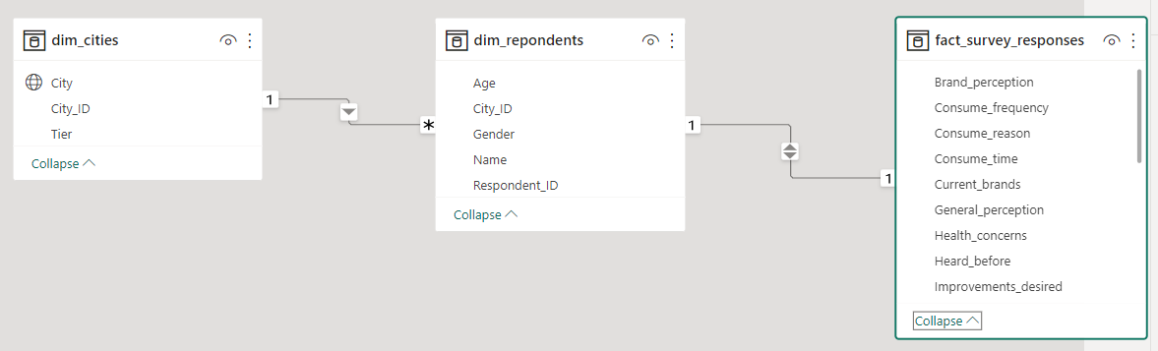

DATA GIVEN
There are 3 table are given in a dataset. which having one to one and one to many relationship between them. dim_cities [city_id] having the relationship with dim_repondents and dim_repondents[respondent_id] having the relation with fact_survey_responses.

Slide 5
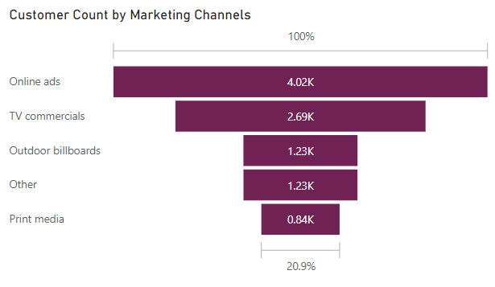


FOOD & BEVERAGE INDUSTRY SURVEY REPORT

Slide 6
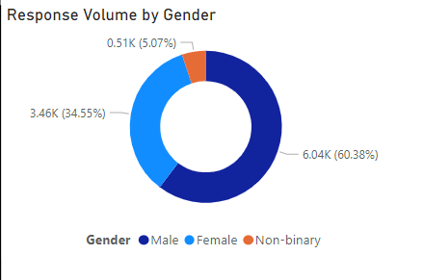
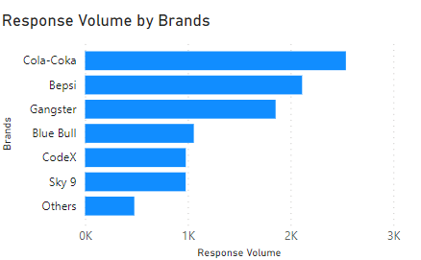
FOOD & BEVERAGE INDUSTRY SURVEY REPORT

Slide 7

SQL
TECHNOLOGY USED
PowerBI
Power Query
Microsoft Excel
Canva

Slide 8





Thank You

